Slide 1

QuantumShield
Best Introduction: An end-to-end, agentic Post-Quantum Cryptography (PQC) and software platform. We unite 14 specialized modules to bridge the gap between vulnerable classical systems and tomorrow's NIST-standardized quantum-safe infrastructure.

Slide 2
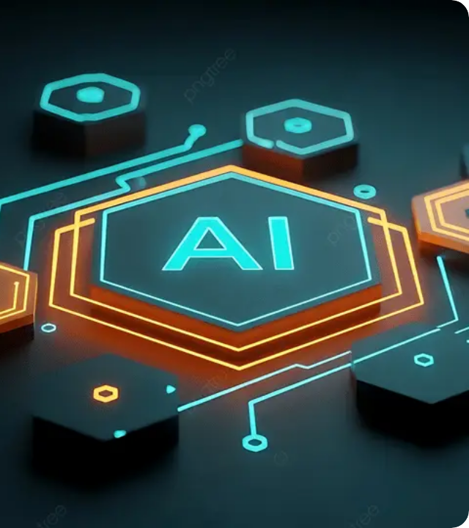


The Quantum Threat
Classical cryptography relies on the difficulty of composite modulus factorization. Shor's Algorithm solves this exponentially faster.
Tab 2 & 3: Our Threat Matrix models Q-Day timelines, proving that polynomial time complexity shatters RSA and ECC, necessitating immediate migration to PQC.

Slide 3

Sandbox & Benchmarks
Key Exchange Sandbox (Tab 01)
Constant-Time Benchmarks (Tab 04)
Interactive side-by-side simulation comparing classical RSA-2048 against NIST FIPS 203 ML-KEM-768 algorithms.
Resolves engineering challenges of CPU memory constraints when transitioning to post-quantum signatures.
Visualizes encapsulation/decapsulation steps.
Microsecond precision benchmarking.
Overhead comparisons: ML-DSA, SLH-DSA, RSA.
Analyzes ciphertext size and shared secrets.
Demonstrates hybrid lattice-based network security.
Constant-time side-channel resistance verifier.

Slide 4


AI Migration Audit Engine (Tab 05)
Automate the manual, error-prone process of identifying hardcoded legacy cryptography in massive enterprise codebases.
Intelligent Scanning: Server-side Gemini models detect MD5, SHA-1, and RSA calls.
AST Migration: Abstract Syntax Tree generates robust structural upgrades.
One-Click Refactor: Instant replacement with NIST-compliant PQC snippets.

Slide 5



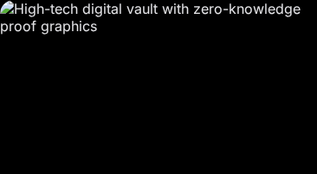
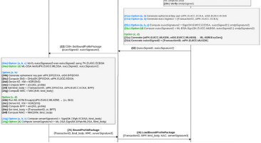
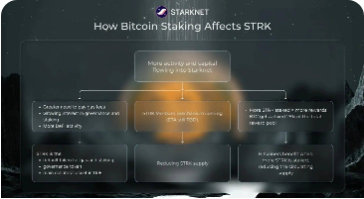
Post-Quantum Ecosystem
PQC Encrypted Vault (Tab 06)
Payment Gateway (Tab 07)
Crypto Exchange (Tab 12)
Multi-currency checkout verified via ML-DSA-65 signatures, eliminating on-chain signature spoofing.
Live spot order books modeling Uniswap v3 routing with instant, PQC-protected token swapping.
Hybrid ML-KEM-768 lattice encapsulation with AES-256-GCM ensures file survival against SNDL attacks.

Slide 6



Research & Cryptanalysis Tools
Crypto Transformer (Tab 08)
Agentic CTF Arena (Tab 09)
Dedicated SHA-224 calculator supporting hex/binary. Audits padding oracles and length extension attack vulnerabilities mandated by specific protocols.
Interactive challenges covering LLL lattice reduction, Shortest Vector Problem (SVP), and side-channel timing analysis. Trains security engineers practically.

Slide 7

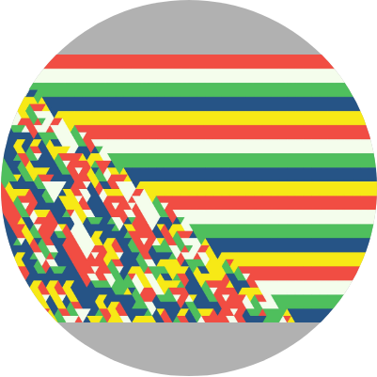
KeyHunt & Cellular Automata (Tab 10)
Entropy Generation Modeling
Demonstrates how emergent cellular automata entropy can be harnessed for cryptographic randomness.
Game of Life: Grid execution linked to entropy.
Key Range Scanner: Visual Secp256k1 exploration.
Live Telemetry: State, population, and generation data.

Slide 8
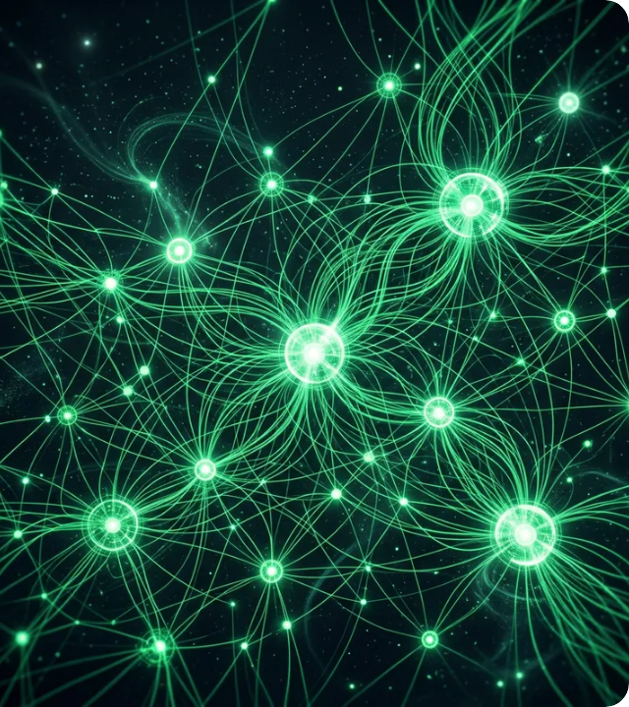
The Agency (Tab 11)
A multi-agent autonomous AI workforce hub designed to eliminate operational bottlenecks during complex migrations.
230+ AI Agents deployed.
Elite PQC Squads & Auditors.
Dynamic task delegation.
Teams autonomously audit, refactor, and test cryptographic systems entirely in parallel.

Slide 9

Omniversal Magic Box (Tab 13)
Provides a single, unified supreme control interface translating high-level natural language desires into execution across software and physical systems.
Single-Command Intent: Orchestrates all 14 modules.
1-Click Workflows: Full Virtual & Physical PQC Rollout.
Dual-Realm Engine: Code artifacts and physical edge hardware actuation logs.

Slide 10






Agentic Quantum Algo Generator (Tab 14)
QKAN & PQK Models
QRC & Q-MCMC
Autonomous Export
Quantum Kolmogorov-Arnold Networks use trainable B-splines. Projected Quantum Kernels eliminate barren plateaus in massive Hilbert spaces.
Quantum Reservoir Computing utilizes thermalized entanglement for forecasting, while Q-MCMC accelerates stationary sampling via quantum walks.
Automates mathematical synthesis, generating circuit schematics and exporting telemetry directly to PennyLane, Qiskit, and Solidity.

Slide 11
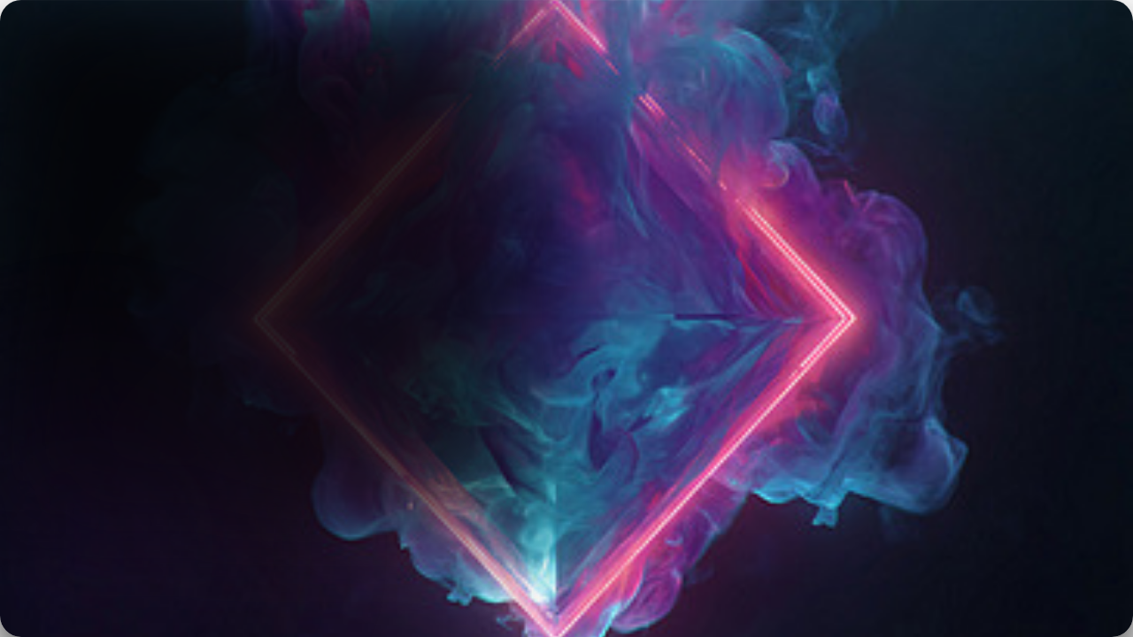
Best Summary
The QuantumShield platform has been completely assembled, verified, and compiled. Every tab is connected via a seamless navigation system. By merging cutting-edge AI autonomy, interactive simulation, and rigid NIST cryptographic standards, QuantumShield sets a world-class benchmark for next-generation digital defense and post-quantum preparedness.

Slide 12

References & NIST Standards
NIST Standard / Concept | Algorithm Target | Platform Module Utilization
FIPS 203 (ML-KEM) | Key Encapsulation / Transport | Key Exchange Sandbox, Encrypted Vault
FIPS 204 (ML-DSA) | Digital Signatures | Payment Gateway, Crypto Exchanges
FIPS 205 (SLH-DSA) | Stateless Hash Signatures | AI Migration Audit Replacements
Shor's Algorithm | Factorization Risk Modeling | Shor's Threat Matrix, Quantum Lab

Slide 13
Ready for Q-Day?
Secure the Future. Deploy QuantumShield Today.

Slide 14






Image Sources
https://png.pngtree.com/thumb_back/fw800/background/20260128/pngtree-futuristic-ai-technology-symbol-surrounded-by-glowing-neon-hexagons-in-dark-image_21236705.webp
Source: pngtree.com
https://assets.ibm.com/is/image/ibm/pdf01705
Source: www.ibm.com
x-raw-image:///59e47eb501a03c3cb33df61c368fdc83a94f8e0230bda54485d17d7cb27034c1
Source: ir.vistas.ac.in
https://www.mdpi.com/sensors/sensors-26-04683/article_deploy/html/images/sensors-26-04683-g002-550.jpg
Source: www.mdpi.com
https://www.starknet.io/wp-content/uploads/2025/11/How-Bitcoin-Staking-Affects-STRK.jpg
Source: www.starknet.io
https://images.squarespace-cdn.com/content/v1/59413d96e6f2e1c6837c7ecd/1591668496436-LGK0Q1IKF11JXAF80R8B/complex2.jpeg
Source: www.artnome.com

Slide 15



Image Sources
https://media.easy-peasy.ai/9754110f-aabf-44fd-88e1-a0e24139e474/64b088d6-6392-4e9b-9870-069f42014edc_medium.webp
Source: easy-peasy.ai
https://cpostrategy.media/wp-content/uploads/sites/2/2026/06/Cover.CPO73.jpg
Source: cpostrategy.media
https://png.pngtree.com/thumb_back/fh260/background/20250518/pngtree-neon-smoke-cloud-digital-art-with-diamond-frame-and-glow-effects-image_17313443.jpg
Source: pngtree.com

